Slide 1
Lecture 03: Software Requirements and Specifications

Slide 2
Requirements
Its not enough to do your best: You must KNOW what to do and THEN do your best
-- W. Edwards Deming

Slide 3
Importance of Correct Requirements
Incorrect requirements may result in:
Increased cost of development
Delayed release of the product

Slide 4
Requirements
Description of the services provided by the system and its operational constraints.
Reflect the needs of a customer for a system.
Complete description of WHAT the system does, NOT HOW it does things.
They capture the external behaviour of the system to be built

Slide 5
Sources of Requirements
Stakeholders – people who will be affected by the system, directly or indirectly e.g. End users, System administrators, Engineers maintaining the system, Business managers
Documentation e.g. organisational charts, process models or standards, and user or other manuals of existing systems.
Business area/domain
Existing System(s)
Notes:
Stakeholders – people who will be affected by the system, directly or indirectly
e.g. End users, System administrators, Engineers maintaining the system, Business managers
Documentation e.g. organisational charts, process models or standards, and user or other manuals of existing systems.
Business area/domain
Existing System(s)

Slide 6
Example of requirements
The system shall allow users to select search for a vehicle by make, model, or year of manufacture.
The system shall support at least 10 transactions per second. - performance and efficiency captured (constraint)

Slide 7
Types of Requirements
Functional Requirements
Describe what the system does; interaction between the system and the environment; how the system should respond to stimuli;
Statements of services the system should provide, how the system should react to particular inputs and how the system should behave in particular situations.
Example: For a library system;
The system shall provide appropriate viewers for the user to read documents in the store.
Should be both complete and consistent.
Completeness: All services required by the user should be defined.
Consistency: Requirements should not have contrary definitions.
Notes:
For large and complex system its difficult to meet the above goals as its easy to make mistakes and different stake holders may often have different and inconsistent needs

Slide 8
More Functional Requirements examples
1. The user shall be able to search either all of the initial set of databases or select a subset from it.
2. Every order shall be allocated a unique identifier (ORDER_ID) which the user shall be able to copy to the account’s permanent storage area.

Slide 9
Types of Requirements
Non-functional Requirements:
Constraints/restrictions on the services offered by the system e.g. timing constraints, performance constraints, usability, constraints on the developing process and standards.
Usually apply to the system as a whole.
Not directly concerned with the specific functions delivered by the system.
Examples: system performance, security, availability
Notes:
Constraints/restrictions on the services offered by the system
User Interface Requirements
Constraints placed upon the system to ensure usability
System Requirements
Constraints placed upon the system by physical or environmental factors
Performance Requirements
Constraints placed upon the operation of the system in order to achieve stated goals
Key words
Must/Shall - system has to do this, cannot be delivered without
Should - important, but not essential for the system to do this
Will - possibility, but could be eliminated or postponed to another release
Discussion Topic: Brainstorming - requirements for university registration system?

Slide 10
Types of Requirements: NFR
The ‘IEEE-Std 830 - 1993’ lists 13 non-functional requirements to be included in a Software Requirements Document.
  Performance requirements
  Interface requirements
  Operational requirements
  Resource requirements
  Verification requirements
  Acceptance requirements
  Documentation requirements
  Security requirements
  Portability requirements
  Quality requirements
  Reliability requirements
  Maintainability requirements

Slide 11
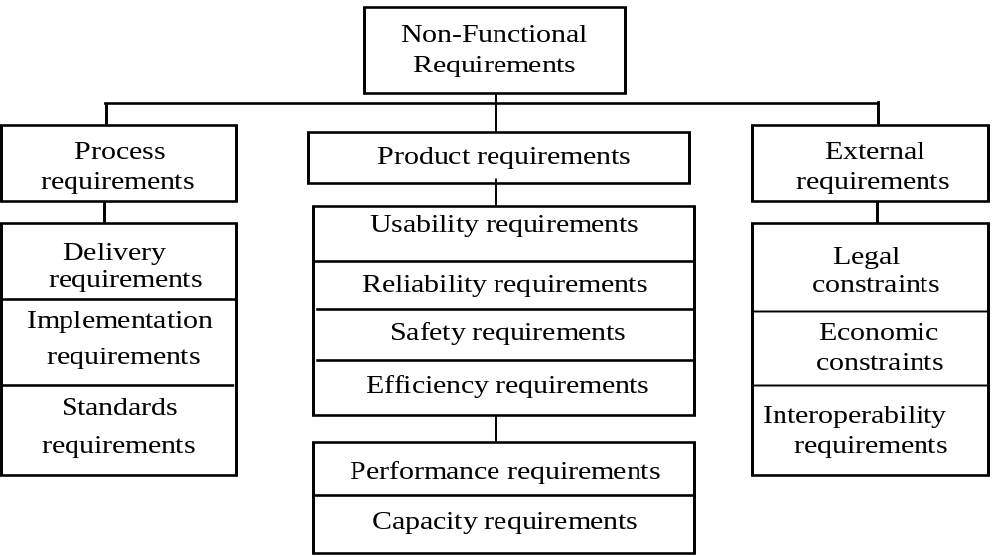
Types of Requirements:
Classification of NFR’s
Notes:
A more general classification distinguishes between product, process and external requirements.
These specify the desired characteristics that a system or subsystem must possess.
The System service X shall have an availability of 999/1000 or 99%. This is a reliability requirement which means that out of every 1000 requests for this service, 999 must be satisfied.
System Y shall process a minimum of 8 transactions per second. This is a performance requirement.
Process requirements
These are constraints placed upon the development process of the system. They include:
Requirements on development standards and methods which must be followed
CASE tools which should be used
The management reports which must be provided
Examples
The development process to be used must be explicitly defined and must be conformant with ISO 9000 standards.
The system must be developed using the XYZ suite of CASE tools
External requirements
These may be placed on both the product and the process and are derived from the environment in which the system is developed. They are based on:
application domain information
organisational considerations
the need for the system to work with other systems
Medical data system: The organisation’s data protection officer must certify that all data is maintained according to data protection legislation before the system is put into operation.
The requirement above comes from the need for the system to conform to data protection legislation.

Slide 12
User Requirements
Should describe functional and non-functional requirements so that they are understandable by system users who don’t have detailed
technical knowledge
Defined using natural language, tables and
diagrams

Slide 13
Detailed User requirement
3.5.1 Adding nodes to a design
3.5.1.1
The editor shall provide a facility for users to add nodes of a specified type to their design.
3.5.1.2
The sequence of actions to add a node should be as follows:
1. The user should select the type of node to be added.
2. The user should move the cursor to the approximate node position in the diagram and indicate that the node symbol should be added at that point.
3. The user should then drag the node symbol to its final position.
Rationale: The user is the best person to decide where to position a node on the diagram.
This approach gives the user direct control over node type selection and positioning.

Slide 14
Problems with natural language
Lack of clarity
Precision is difficult without making the document difficult to read; i.e. verbose
Requirements confusion
Functional and non-functional requirements tend to be mixed-up
Requirements mix-up
Several different requirements may be expressed together as one requirement

Slide 15
Guidelines For Writing Requirements
Invent a standard format and use it for all requirements
Use language in a consistent way.
Use “shall” or “must” for mandatory requirements; cannot be delivered without
“should” for desirable requirements; important, but not essential for the system to do this
“will” possibility, but could be eliminated or postponed to another release
Use text highlighting to identify key parts of the requirement
Avoid the use of computer jargon

Slide 16
System requirements
More detailed specifications of user requirements
Serve as a basis for designing the system
May be used as part of the system contract
Examples: Hardware Requirements, Platform requirements

Slide 17
Sample System requirements
The PC Game Spider-Man (2002) needed:
3D Hardware Accelerator
Windows 98/2000/NT/XP
Pentium III processor at 500 MHz or higher
128 MB RAM
1.5 GB available in the hard disk
DirectX 8.1

Slide 18
Specification
The process of establishing what services are required and the constraints on the system’s operation and development.
Seeks to map out the WHAT in software development.
Requirements engineering is the process of developing a software specification.
Requirements engineering process
Feasibility study
Requirements Elicitation and Analysis: determining user needs; understanding the relationships among various requirements and shaping those relationships to achieve a successful result
Requirements Specification: developing a tangible model of the requirements
Requirements Validation: ensuring that the requirements satisfy the conditions specified
The FOUNDATION of the software product
Notes:
The fifth process of RE is requirements Management: identifying, controlling and tracking requirements and the changes that will be made to them

Slide 19
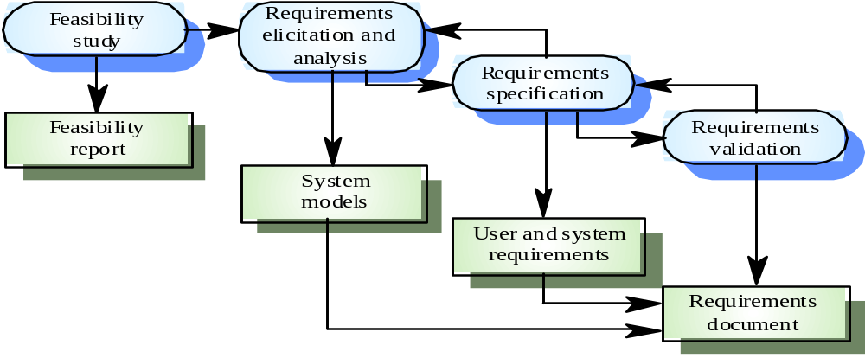
Requirements Engineering

Slide 20
Feasibility Study
Undertaken to determine the possibility or probability of either improving the existing system or developing completely the new system.
Assessing whether the system is useful to the business.
Can we do this with the available tools, time and budget constraints.
Does the system contribute to the overall objectives of the organisation?
Can the system be integrated with other systems which are already in place?
Result is a feasibility study report recommending whether or not its worth carrying on with the project.
Notes:
Economic Feasibility
This first seeks to identify alternatives, and then determines the saving and expected cost of each alternative
Operational Feasibility
This seeks to answer questions like:
Will the system be useful after it is implemented?
Will there be resistance from users?
Technical Feasibility
Can the work for the project be done with the present equipment, current procedures, existing software technology, and available personnel?

Slide 21
Feasibility Report
Consists of:
Statement of the problem
Details of findings
Findings and recommendations in concise form

Slide 22
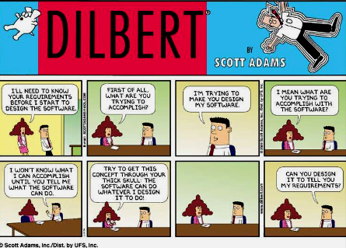
Requirements Elicitation
Finding out what the customer wants

Slide 23
Requirements Elicitation
IS Identifying what is needed from the system.
NOT how the system will achieve its goals
Software Engineers work with customers and system end users.

Slide 24
The Requirements Elicitation Process
Establish objectives - Check with business goals, problem to be solved, system constraints
Understand Background - Look at the organisational structure, Application domain, and Existing systems
Organise knowledge - This entails stakeholder identification, goal prioritisation and domain knowledge filtering
Collect Requirements -These might be stakeholder requirements, domain requirements, organisation requirements

Slide 25
Techniques for Requirements Elicitation
On identifying requirements sources, the software engineer can start eliciting requirements from them.
On-site Observation
Interviews
Questionnaires
Brainstorming
JAD Sessions
Documentation Review
Storyboarding
Scenarios and Use cases

Slide 26
Elicitation Techniques: Interviews
System Analysts collect information from individuals through face to face interaction with potential users of the system.
Useful for finding facts, clarifying facts, verifying facts, getting the end user involved, identifying requirements, soliciting ideas and opinions.
Structured: preset agenda; clear interview purpose and scope and questions are determined beforehand.
Unstructured: a.k.a ‘open-ended’;no preset agenda, notes or questionnaires; might involve a face-to-face dialogue

Slide 27
Elicitation Techniques: Documentation Review
Purpose is to understand what needs to be done.
It is used as basis for further study, business process definition, interviews, etc
Examples of sources: company reports, organisation charts, policy manuals, job descriptions, documentation of existing systems, Request for Proposal, statement of work, contract/task order, proposal, standards
Applicable: Whenever one is unfamiliar with the organization being investigated.

Slide 28
Elicitation Techniques: Questionnaires
Special-purpose document that allows the analyst to collect information and opinions from respondents.
Open Ended questionnaire - Designed to offer the respondent greater flexibility in answering. Provides spaces after question for respondent to record the answer.
Closed ended questionnaire – Questions are presented such that they require selecting an answer from pre-defined available responses. Eliminates subjectivity of open ended questionnaires.

Slide 29
Elicitation Techniques: Brainstorming
A group technique for generating ideas
Involves both idea generation and idea reduction.
Allows people to suggest and explore ideas in an atmosphere free of criticism and judgment.
Generation phase – As many ideas as possible are offered BUT there is no discussion of their merits. ‘a.k.a. idea generation.’
Consolidation phase – The ideas previously offered are discussed, revised, and organized. ‘a.k.a. idea reduction’

Slide 30
Elicitation Techniques: Storyboarding
A Storyboard is a logical and conceptual description of system functionality for a specific scenario, including the interaction required between the system users and the system.
Storyboards "tell a specific story“; identify the players, explain what happens to them, and describes how it happens.
The purpose is to elicit early “Yes, But” reactions.
Can be Passive, Active or Interactive
Notes:
It is a series of illustrations and images displayed in sequence for the purpose of pre-visualizing requirements: applicable mainly in HCI
First time users see the system the first reaction is either, “wow this is so cool” or “Yes, but, hmmmmm, now that I see it, what about this…? Wouldn’t it be nice …?
Passive storyboards
These tell a story to the user and consist of sketches, pictures, screen shots, PowerPoint presentations, or sample application outputs. They walk the user through, with a “When you do this, this happens” explanation.
Active storyboards
These try to make the user see “a movie that hasn't actually been produced yet” providing an automated description of the way the system behaves in a typical usage or operational scenario.
Interactive storyboards
Let the user experience the system in as realistic a manner as practical and thus require participation by the user.

Slide 31
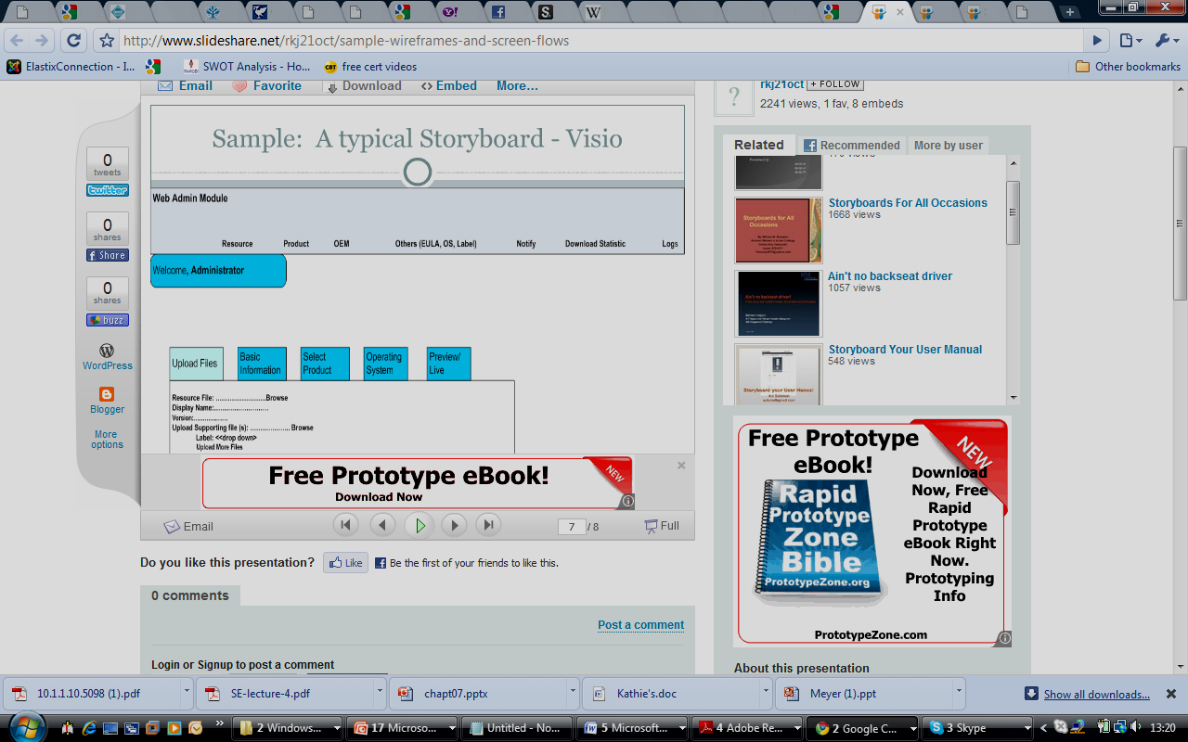
Example of UI Storyboard

Slide 32
Elicitation Techniques: Observation
People often find it hard to describe what they do because it is so natural to them.
Therefore the best way to understand it is to observe them at work.
Actual work processes often differ from formal, prescribed processes.
Involves an observer spending an extended period in an organisation, making detailed observation of all their practice, and building up a picture of how work is done.
A.K.A Ethnography

Slide 33
Elicitation Techniques: JAD Sessions
Technique for promoting co-operation, understanding and teamwork among clients and developers.
Facilitates the creation of a shared vision of what the system should be.

Slide 34
Elicitation Techniques : Scenarios and Use cases
Valuable means for providing context to the elicitation and clarification of user requirements.
Most common type of scenario is the Use Case:
Sequence of actions that the system performs that yields an observable result of value to an actor.
Standard way of capturing, exploring and documenting what a system should do.
Represents a series of interactions between an outside entity and the system.

Slide 35
Prototyping
It is a methodology to gather and validate requirements for rapid software development.
A visualization of an application that hasn't yet been constructed.

Slide 36
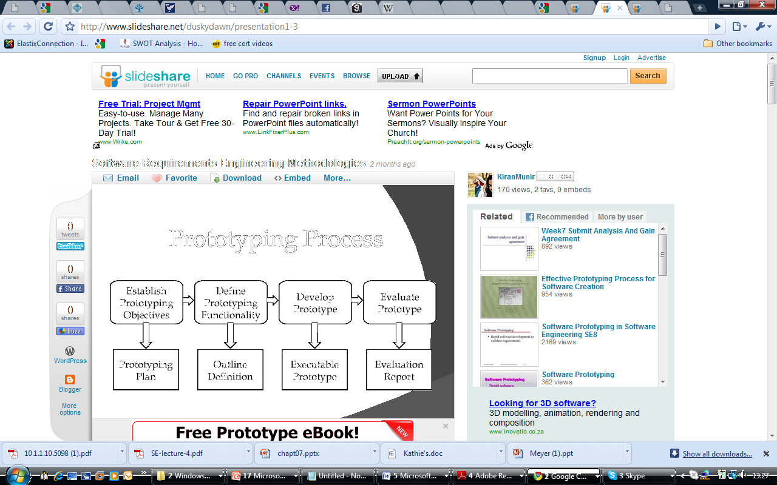
Elicitation Technique: Prototyping process

Slide 37
Prototyping styles
Evolutionary or operational prototyping
Refine prototypes; last prototype is used for design
Throw-away or Exploratory prototyping
practical implementation; discard prototype on finalizing requirements.
Incremental prototyping
Final product is built as a separate prototype.
Notes:
Evolutionary or operational prototyping – The initial prototype is produced and refined through a number of stages to the final system. The last prototype is thus used as the starting point for the design of the production system.
Throw-away or Exploratory prototyping – It is a practical implementation of the system and help to discover requirement problems. After the system requirements have been finalized, the prototype is discarded.
Incremental prototyping - used to build the final product as a separate prototype.

Slide 38
Prototyping Application
Systems where the user requirements are unclear, ambiguous or incomplete. Prototyping helps clarify the requirements.
Systems with a major user interface and/or a lot of user interaction.
Prototyping is a form of risk sharing between the user and the developer
Where there is the much required strong commitment from the user(s) to evaluate and improve the prototype.

Slide 39
Challenges in Elicitation
Ill-defined system boundaries or unnecessary technical detail may confuse, rather than clarify system objectives.
Ambiguous understanding of processes; customers may not be sure of what they want
Inconsistency within a single process by multiple users
Insufficient input from stakeholders; omit ‘the obvious’
Conflicting stakeholder interests
Changes in requirements after project has begun
People find it hard to describe regularly used knowledge.
Collaboration of people from different backgrounds.

Slide 40
Requirements Analysis
Done in order to understand the problem which the software system is to solve.
Specifically, it involves building models that depict user scenarios, functional activities, problem classes and their relationships, system and class behaviour, and the flow of data as it is transformed.
Result is System Models

Slide 41
Analysis Modelling
The objectives of analysis modelling include:
To describe what customer requires
To establish basis for creating software design
To define requirements that can be validated
Two primary methods:
Structured analysis
Object Oriented analysis
Each analysis method has techniques for representing: Data, Processing/Function and Control/Behaviour

Slide 42
Structured Analysis/Traditional approach
This approach holds three main views of the analysis model:
Process/function(al) view
Sequence of data movement and handling operations within the system. Represented by data flow diagrams.
Data structures/ Data view
Represents the inherent structure of data independent of how or when it is processed. Represented by Entity-relationship diagrams.
Logic and timing/behavior view
A.K.A time-dependent behavior view. It describes what goes on inside the process boxes in the data flow diagrams and when these processes occur. It is modeled using State-transition diagrams.

Slide 43
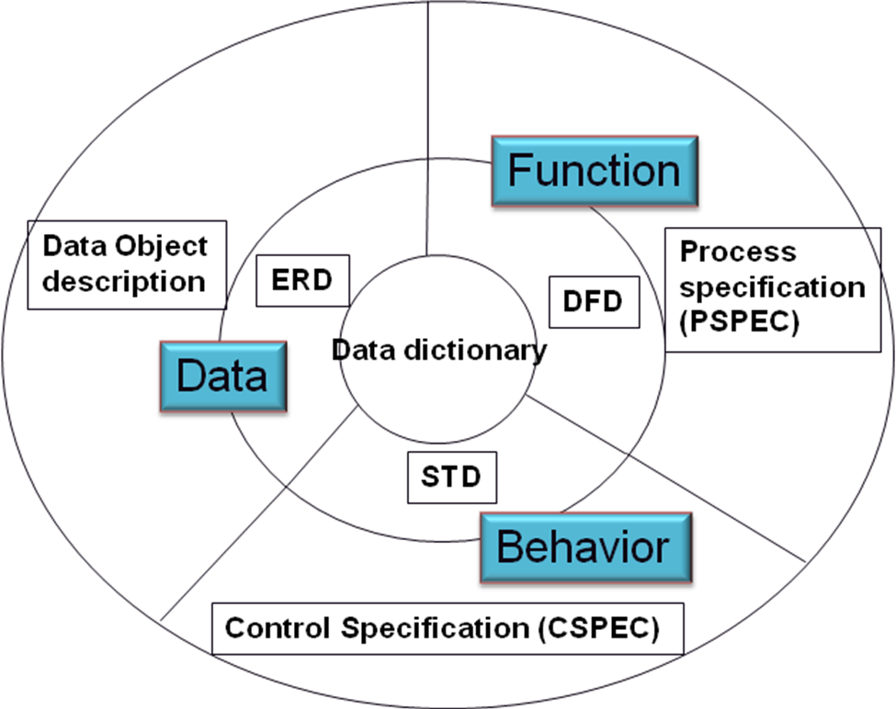
Structured Analysis Model

Slide 44
Structured Analysis: Process Modelling
A.K.A. Functional Modelling
Purpose of the process model is to create a pictorial representation of the functions and operations (i.e., the processes) that will eventually be performed by the system being developed.
Modelling is done using Data Flow Diagrams and these are accompanied by descriptions by the Process Specification.

Slide 45
Data Flow Diagram (DFD)
Data flow diagrams illustrate how data is processed by a system in terms of inputs and outputs.
A DFD is a graphical representation of
the processes of a system,
the data being transformed and stored
Gives a very good overview of what is happening in the system.

Slide 46
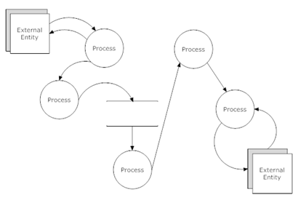
Data Flow Diagram (DFD)

Slide 47
Data Flow Diagram (DFD)
  Producer/Consumer of information outside the bounds of the system; Source/sink
  Transformer of information
  Data item or collection of data items
  Repository of data stored for one or more processes
External
Entity
Process
Data
Item
Data Store

Slide 48
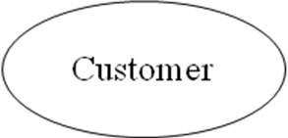
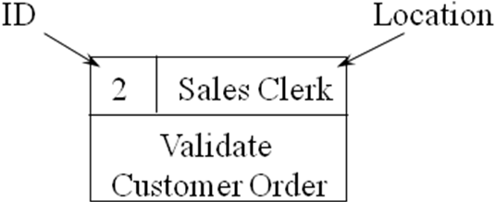

DFD– Alternative Notation
  Producer/Consumer of information outside the bounds of the system; Source/sink
  Transformer of information
  Data item or collection of data items
  Repository of data stored for one or more processes
Data
Item

Slide 49
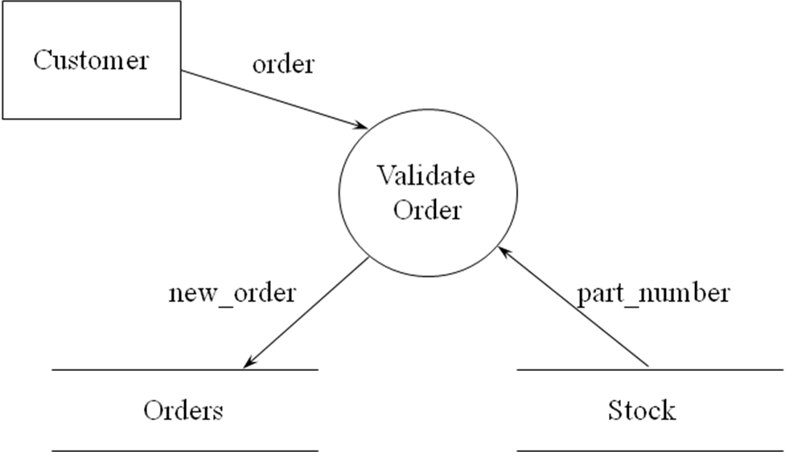
Data Flow Diagram: Example

Slide 50
Data Flow Rules: Don’ts
BLACK HOLES
MIRACLES
Let it get too COMPLEX: 7 ± 2 processes
Leave things UNLABELED (corollary: labels should have meaning)
Data stores that are “SOURCES” or “SINKS”
Data flows that are UNASSOCIATED with a PROCESS
Expect your diagram to be “perfect” the first time!

Slide 51
DFD Don’ts
process
stuff
1. ‘Black Hole’
process
stuff
2. ‘Miracle’

Slide 52
DFD Don’ts
ds-1
P.1
P.2
data
4. Leave Things Unlabeled
Corollary: Labels Should Have Meaning

Slide 53
DFD Don’ts
data store
5. Miracle data source
5. Black hole data sink
data store

Slide 54
DFD Don’ts
  6. Data Flows Unassociated With a Process
entity to entity
Data store to entity - or reverse
data store to data store

Slide 55
DFD Leveling
DFD’s allow analysts to look at the system at different levels of detail.
Having many processes included in a single diagram can make it
  look cluttered,
  difficult to see in detail what a process does.
Therefore to overcome this, a single diagram is ‘broken down’ into a number of diagrams. This is known as DFD leveling.

Slide 56
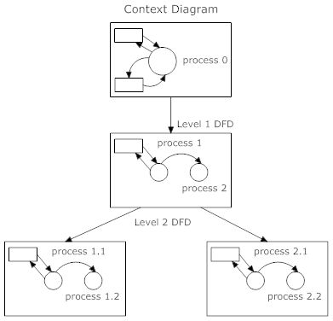
DFD Levelling Illustration

Slide 57
Data Flow Diagrams: Context diagram
This level of the DFD represents the system at the highest level of detail.
Comprised of:
  A single process representing the entire system modeled;
  All External entities
  The data flows that pass between the external entities and the system
It is also called the overview or Level 0 Diagram
Purpose is to identify and examine the interfaces between the external entities and the system.

Slide 58
Guidelines For drawing a context Diagram
List potential external entities (people, places). Look for entities that:
  give data to the system without explaining the process that creates that data
  take data from the system without explaining what it does with that data
List potential data stores
Establish what flows are sent to and from the system from the external entities
Draw the context diagram

Slide 59
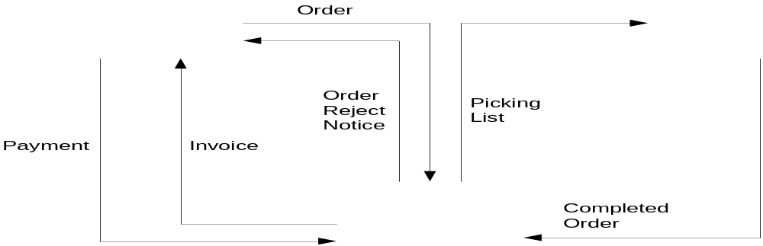
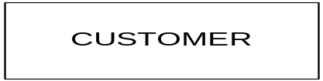
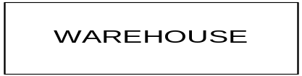
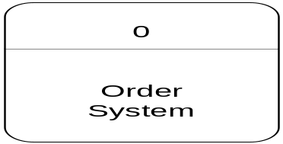
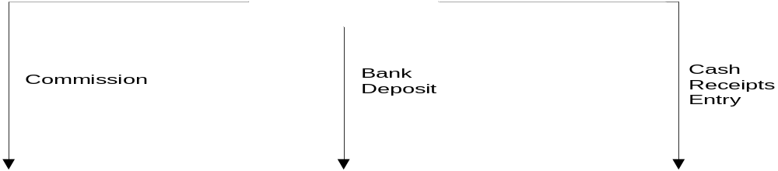

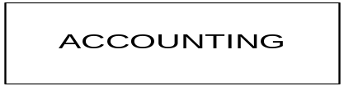

Context Diagram for an Ordering system

Slide 60
Data Flow Diagrams: Level 1 DFD
This diagram shows;
  the system in more detail
  how data enters the system
  how these data items are transformed by the processes
  how they leave the system
Data flows are connected to and from the actual processes which create, receive or change the data.
Notes:
However, the level 1 diagram must have the same number of inputs and outputs as its context diagram (same sources and sinks).
Note: The processes detailed usually represent a breakdown of the activities or functions that make up the system (the single context diagram process).

Slide 61
Guidelines for drawing a Level 1 Diagram
Taking one sentence at a time try to identify potential processes (look for verbs)
Group potential processes so you end up with (minimum) 3 to (maximum) 9 or 10
Identify and list the data flows (generally documents but could also be physical items). Anything that moves around the system.
Identify and list the data stores
Draw the Level 1 diagram

Slide 62
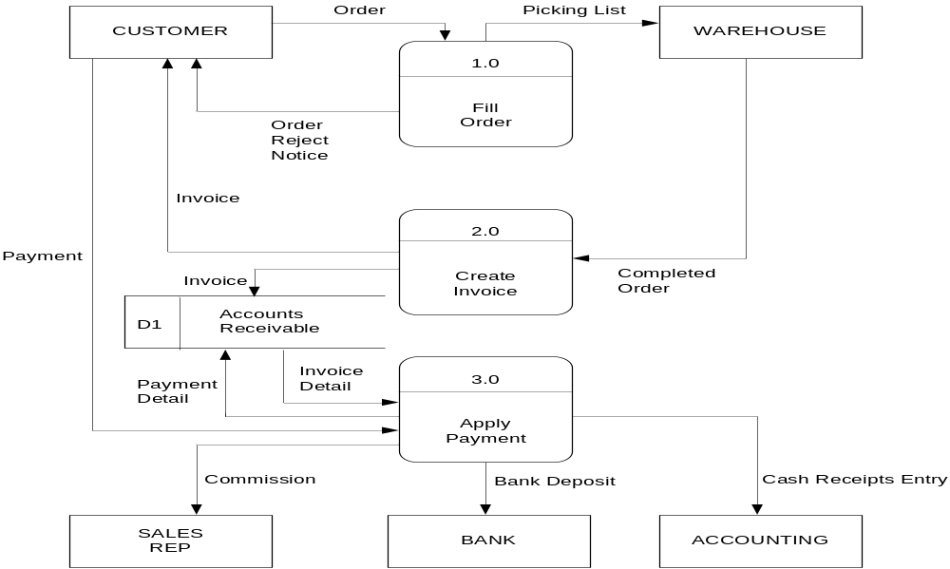
Level 1 DFD of ordering system

Slide 63
Level n DFD
The bottom level DFD (level n) is obtainable as one continues decomposing a DFD into lower levels until the processes get so simple that you can describe them using:
  Process specifications (usually in pseudo code)
  Decision tables

Slide 64
Balancing DFDs
Conserve data from level to level
i.e. inputs and outputs on the higher level must appears somewhere on the lower level

Slide 65
Sample Problem
Perfume Den sells a line of high-quality perfumes. When customers place orders on the company’s Web site, the system checks to see if the items are in stock, issues a status message to the customer, and generates a shipping order to the warehouse, which fills the order. When the order is shipped, the customer is billed. The system also produces various reports.
Draw a context diagram for the order system
Draw DFD diagram 0 for the order system
Notes:
dentify Entities,Process,Data Stores & Data Flow
Entities
Customer
Warehouse
Accounting
Processes
1.0 Check Status
2.0 Issue Status Messages
3.0 Generate Shipping Order
4.0 Manage Accounts Receivable
5.0 Produce Reports
Data Stores
D1 Pending Orders
D2 Accounts Receivable
Data Flows
Order
In-Stock Request
Order Data
Status Data
Status Message
Shipping Order
Order Data
Invoice
Shipping Confirmation
Payment
Accounting Data
Accounts Receivable Data
Order Data
Inventory Reports

Slide 67
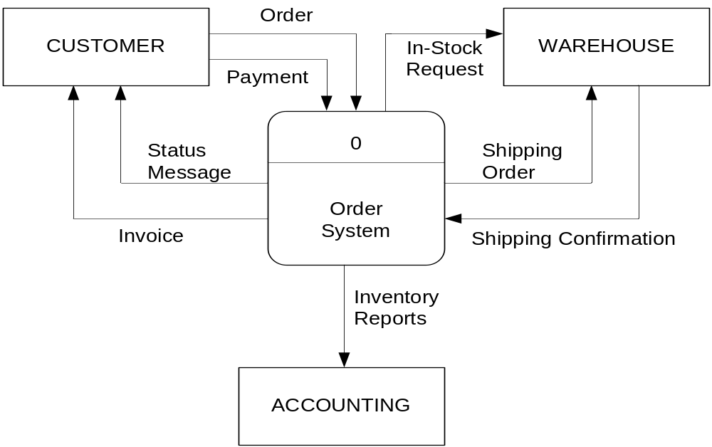
Perfume Den’s Ordering system Context Diagram
Notes:
Perfume Den sells a line of high-quality perfumes. When customers place orders on the company’s Web site, the system checks to see if the items are in stock, issues a status message to the customer, and generates a shipping order to the warehouse, which fills the order. When the order is shipped, the customer is billed. The system also produces various reports.
Draw a context diagram for the order system
Draw DFD diagram 0 for the order system

Slide 68
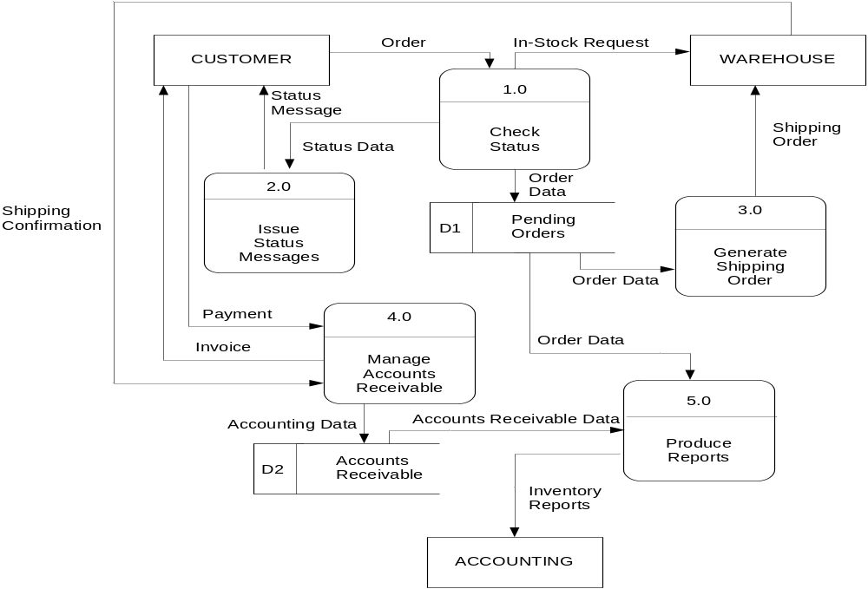
Perfume Den’s Ordering system Context Diagram

Slide 69
Structured Analysis: Data Modelling
Examines data objects independently of processing
Focuses attention on the data domain
Creates a model at the customer’s level of abstraction
Indicates how data objects relate to one another.
A graphical representation of a database
The goal is to identify the facts to be stored in the database

Slide 70
Entity Relationship Diagram: Notation
  Attributes
Define the properties of a data object and may take on one of three different characteristics:
Name an instance of the data object
Describe the instance
Make reference to another instance
For example: Car’s naming attributes are model and make, its description attributes may be colour and body type, and its referential attribute will be the owner.

Slide 71
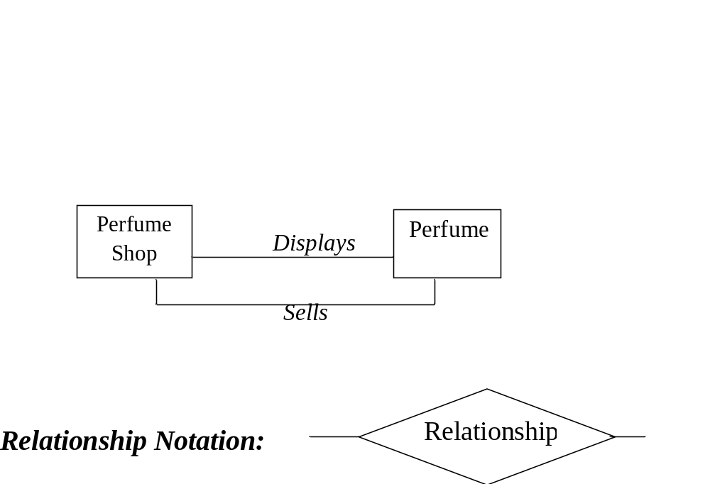
Entity Relationship Diagram: Notation
  Relationships
Defined pair-wise but can have many varieties. Eg. Students take courses, perfume shop sells perfume.
For example

Slide 72
Entity Relationship Diagram: Notation
Cardinality and Multiplicity
This relationship property specifies how many occurrences of object X are related to how many occurrences of object Y.
It could be a:
One- to-one (1:1) e.g. wife - husband
One- to-many (1:N) e.g. mother- children
Many-to-many (M:N) e.g. grandparents-grandchildren
Examples: A man can own more than one car;
A manufacturing company can make more than one type of car.
Notes:
A nation can hace more than one city

Slide 73



Entity Relationship Diagram: Notation
Modality
This property further defines the relationship:
0 means optional relationship (optional relationship)
1 means relationship must appear (mandatory relationship)
For example:
Customer
Repair action
Notes:
MANDATORY for a customer to have the repair action BUT there may be situations in which a repair action is not necessary (OPTIONAL).

Slide 74
Entity Relationship Diagram: Notation
Degree of a relationship
The degree of a relationship is the number of entity types that participate in the relationship.
  Binary relationship (n=2): the most common, it is a relationship between instances of two entity types. e.g husband -wife
  Ternary relationship (n=3): a simultaneous relationship among instances of three entity types.
  Unary relationship (n=1): a.k.a. recursive relationship, it is a relationship between instances of one entity type and is most likely represented as an Boolean attribute.

Slide 75
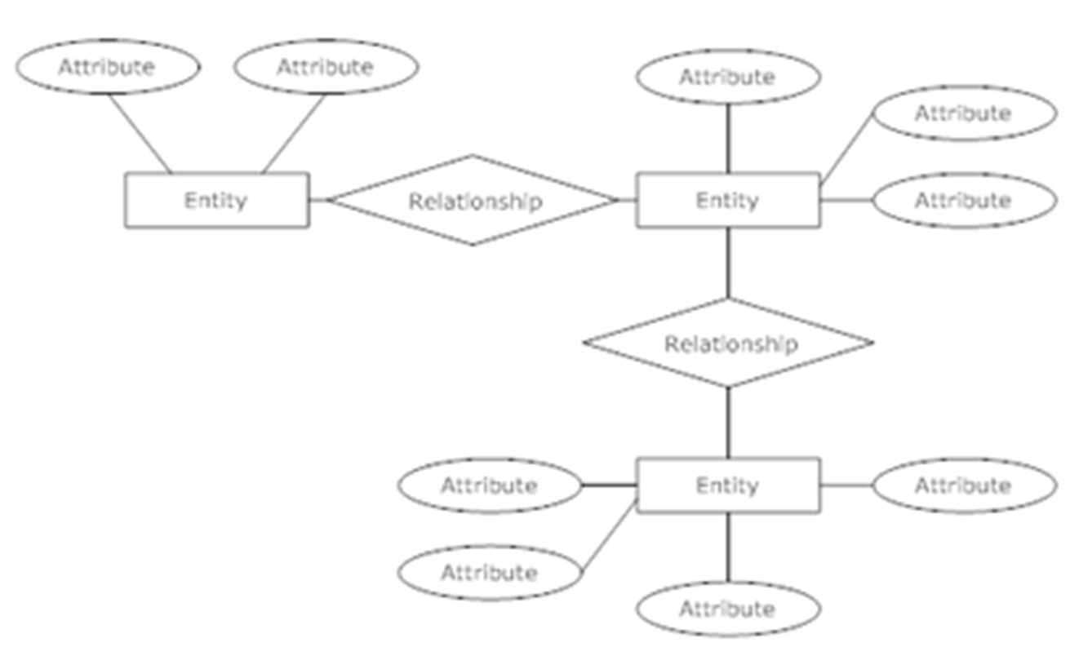
Sample Entity relationship Diagram

Slide 76
ERD Example
The purpose of the credit card system is to provide a means for the company to extend credit to the customer. The system will handle details of credit application, credit management, billing, transaction capture, remittance, and management reporting. Information about transactions should be available to the corporate accounting system.

Slide 77
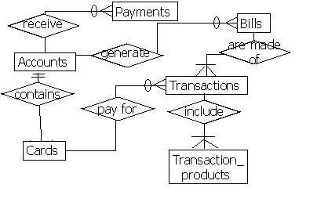
Example: ERD

Slide 78
Entity types
Independent
Dependent
Associative
Aggregate
Subordinate

Slide 79
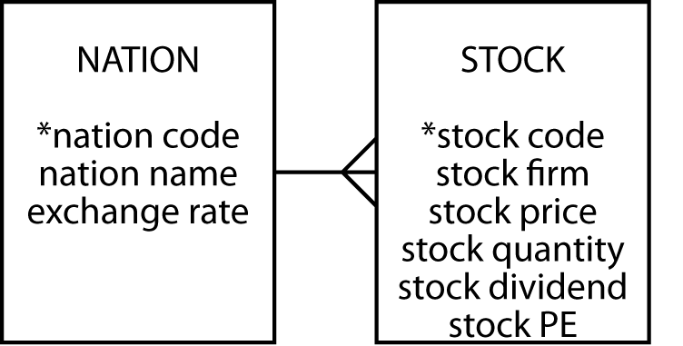
Independent
Often a starting point
Prominent in the client's mind
Often related to other independent entities

Slide 80
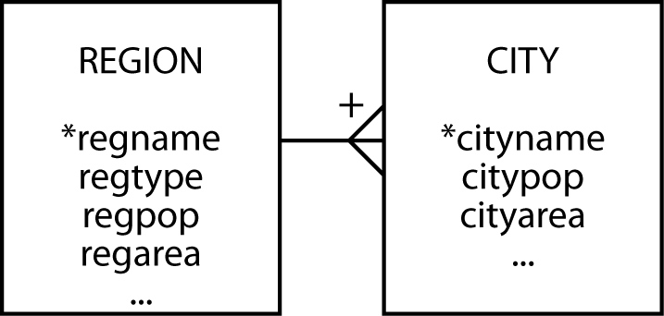
Dependent
Relies on another entity for its existence and identification
Can become independent if given an arbitrary identifier

Slide 81
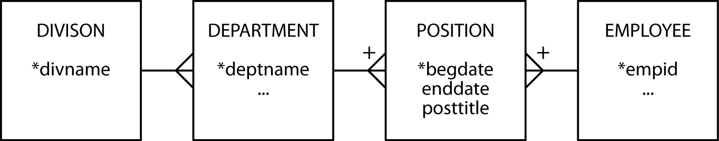
Associative
A by-product of an m:m relationship
Typically between independent entities
Can store current or historical data
Can become independent if given an arbitrary identifier

Slide 82
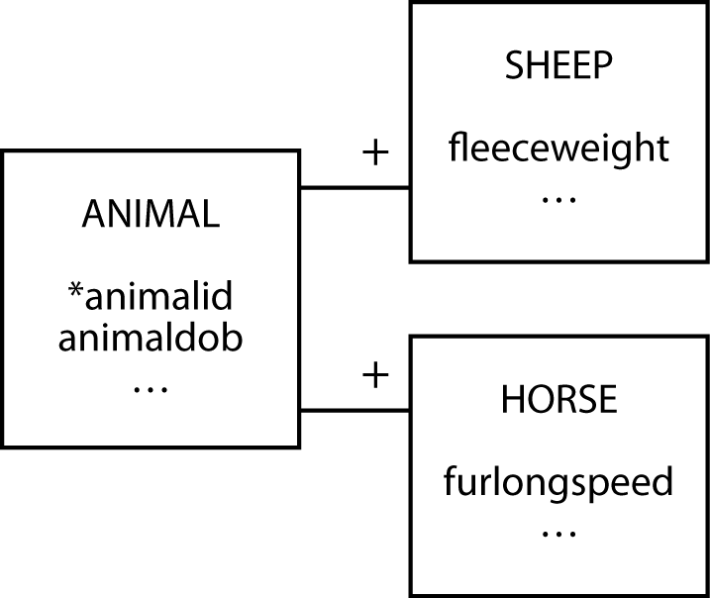
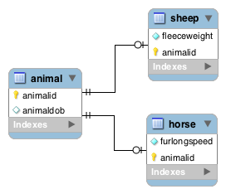
Subordinate
An entity with data that can vary among instances

Slide 83
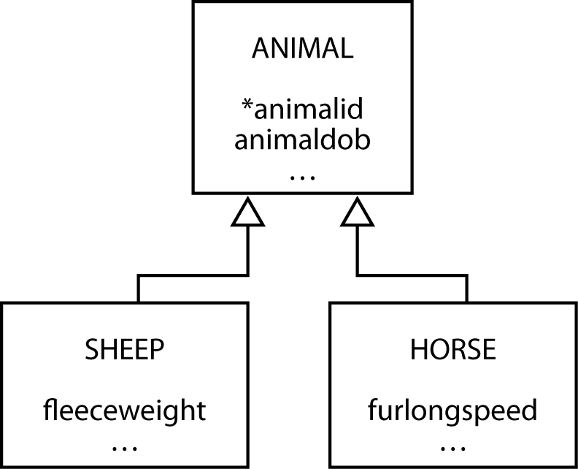
Generalization
A relationship between a more general element and a more specific element

Slide 84
Generalization
Map with one table for each entity
For each of the subtype entities the primary key is that of the supertype entity
You must also make this column a foreign key so that a subtype cannot be inserted without the presence of the matching supertype

Slide 85
Aggregate
Created from several different entities that have a common prefix or suffix
Commonly used with addresses or names

Slide 86
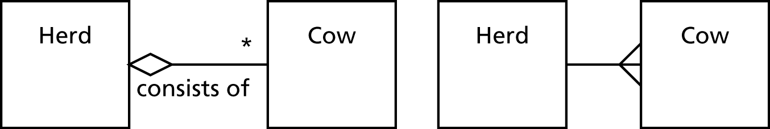
Aggregation
Aggregation is a part-whole relationship between two entities

Slide 87

Shared aggregation
One entity owns another entity, but other entities can own that entity as well

Slide 88

Composite aggregation
One entity exclusively owns the other entity

Slide 89
Creating an ERD
List entities that are addressed.
For each, determine the connections
For each connection, create one or more object-relationship pair.
For each relationship, determine cardinality and modality.
Define the attributes of each entity.
Formalize and review ERD.
Iterate.

Slide 90
Entity-Relationship diagram (ER diagram) Exercises
Design an ER diagram for a student database with the following Entities.
Student (StudentID, Fname, Lname, Age, Gender, AcPID_FK)
Academic Program(AcPID, AcPname, DeptID_FK, duration )
Department (DeptID, Deptname, Depthead)

Slide 91
Behavioural Modelling
“Every body continues in its state of rest, or of uniform motion in a right line,
unless it is compelled to change that state by forces impressed upon it.” Isaac newton

Slide 92
STD: Basic Concepts
State:
  a set of observable circum-stances that characterizes the behavior of a system at a given time
State transition:
  the movement from one state to another
Event:
  an occurrence that causes the system to exhibit some predictable form of behavior; activities that trigger the transition;
Action:
  process that occurs as a consequence of making a transition.
  i.e. an event causes a state transition to an action

Slide 93
State modelling Procedure
Make a list of the different states of a system (How does the system behave?)
Indicate how the system makes a transition from one state to another (How does the system change state?)
  indicate event
  indicate action (and condition) if fit.
Draw a state transition diagram

Slide 94
Notation
State
Event
Initial/idle state
button1&2Pressed
button2Pressed
Blink
Increment
Hours
Hours
Transition
button1Pressed
button1&2Pressed
Blink
button2Pressed
Increment
Minutes
Minutes
button1Pressed
button2Pressed
Stop
Blink
Increment
Blinking
Seconds
Seconds
button1&2Pressed
Final state

Slide 95
Example of a STD
Customer
pays bills
Customer
makes purchase
Active
Account.
Balance
Account
application
Customer
makes purchase
Customer
request to
close account &
pays balance
Create
New Account.
No Balance
Customer
does not
pay bills
Closed
Account.
No Balance
Bad Debt
Account.
Balance

Slide 96
Conditions and actions
Idle
Condition
Condition
Incoming Call
Press Cancel button
Ready to receive light
goes on / Ring tone
Ready to receive button
goes out
Phone Calling
Action
Action
Condition
Caller doesn’t go off
before receiving call
Timer starts
End call with caller 1
and receive another caller2
Notification – Call ended with caller1
Answering
Call
Condition

Slide 97
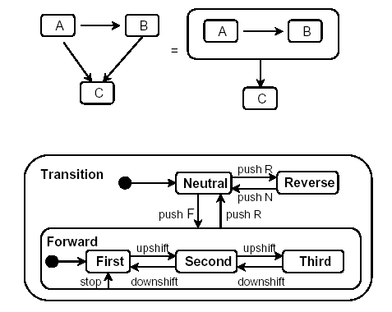
State Generalization

Slide 98
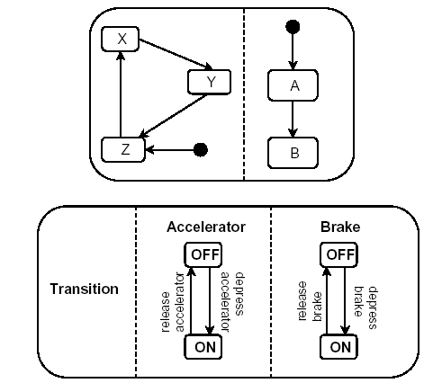
State Aggregation

Slide 99
Data Dictionary
Provides definitions for all elements in the system which include:
  Meaning of data flows and stores in DFDs
  Composition of the data flows e.g. customer address breaks down to street number, street name, city and postcode
  Composition of the data in stores e.g. in Customer store include name, date of birth, address, credit rating etc.
  Details of the relationships between entities

Slide 100
Data Dictionary
Name: the primary name of the composite data item
Aliases: other names for the data item
Where used: data transforms (processes) that use the composite data item
How used: the role of the data item (input, output, temporary storage, etc.
Description: a notation for representing content
Format: specific information about data types, pre-set values (if known)

Slide 101
Data dictionary Notation
Notation Meaning
= is composed of
+ and
(… ) optional data( may be present or absent)
{ } ⁿ iteration(n repititions of)
[ ] select one of several alternatives
*…text…* delimits a comment
@ identifier (key field) for store
| separates alternative choices in the [ ] construct

Slide 102
Sample Data Dictionary Entry
Name: telephone number
Aliases: none
Where used/ how used: assess against set-up (output)
dial phone (output)
Description:
telephone number = [local number | long distance number]
local number = prefix + access number
long distance number = 1 + area code + local number
area code = [800 | 888 | xyz]
prefix = * a three digit number that never starts with 0 or 1 *
access number = * any four number string *

Slide 103
Process specification (PSPEC)
Process Specification (PSPEC) can be used to specify the processing details implied by a process within a DFD.
Purpose:
Reduce process ambiguity as in the DFD
To obtain a precise description of what is accomplished
To validate the system design, including data flow diagrams and the data dictionary.

Slide 104
PSPEC tools
Structured English; psuedo code
Decision Tables; tables, columns
Decision Trees; graphs, branches

Slide 105
Structured English - Calculate Tax Rate
IF goods are Taxable
DO CASE
CASE goods-type = “Food”
set tax-rate to 0
CASE goods-type = “Vehicle”
set tax-rate to 20
CASE goods-type = “Clothes”
set tax-rate to 40
OTHERWISE
set tax-rate to 15
ENDCASE
ELSE
write Tax not applicable to Results data store
ENDIF
Restrictions on using structured English include:
No more than one A4 page long
No more than three levels of nesting
Use indentation to show levels of nesting

Slide 106
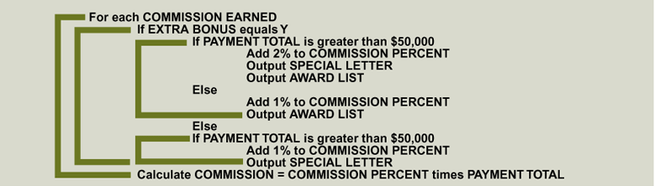
Structured English example: Commision

Slide 107
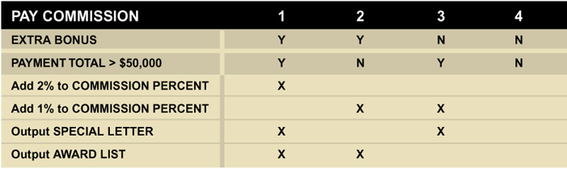
Decision Table

Slide 108
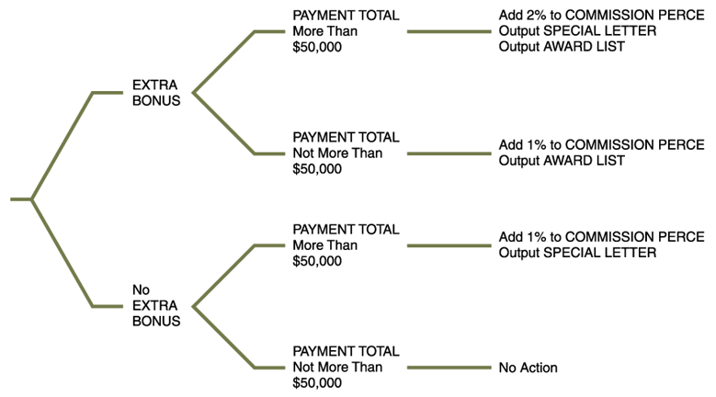
Decision Tree

Slide 109
Requirements Engineering: Requirements Specification
Converting the requirements into a standard form.
Specify :
Functional and non-functional requirements
Formats of inputs and outputs and standards required
Design constraints (political, security, environmental)

Slide 110
Basic concepts of formal specification techniques
A specification expressed in a language whose vocabulary, syntax and semantics are formally defined.
Formal methods allow a software engineer to create a specification that is complete, consistent, and unambiguous.
Usually applied when developing complex critical systems
Notes:
Complete – because the chances that some important issues are left out is lowered
Consistent – because formal specification serves to guide
Unambiguous - reduces requirements errors as it forces a detailed analysis of the requirements.

Slide 111
Basic concepts of formal specification techniques II
Two approaches:
Algebraic approach: system described in terms of operations and their relationships
Model-based approach: model of system is built using mathematical constructs e.g. sets and sequences and system operations are defined by how they modify the system state.

Slide 112
Software Requirements Specification
Document that completely describes what the proposed software should do without describing how the system will do it
Should include:
User requirements
Detailed system requirements specification
Also known as the Software Requirements Document
Useful to management/customers and engineers

Slide 113
Goal of SRS
Provides feedback to the customer; assurance that the developers understand the issues or problems to be solved and the solution software behaviour.
Decomposes the problem into component parts.
Serves as an input to the design specification.
Serves as a product validation check.

Slide 114
Software Requirements Specification
Level of detail included in SRS depends on the type of system to be developed and the process used.
IEEE standard for SRS structure is IEEE/ANSI 830-1998(IEEE, 1998)
The document of the requirement specification will be used as
The agreed contract between the client and the system development organization on what the system should do (and what the system should not do);
The basis used by the development team to develop the system;
A fairly full model of what is required of the system.

Slide 115
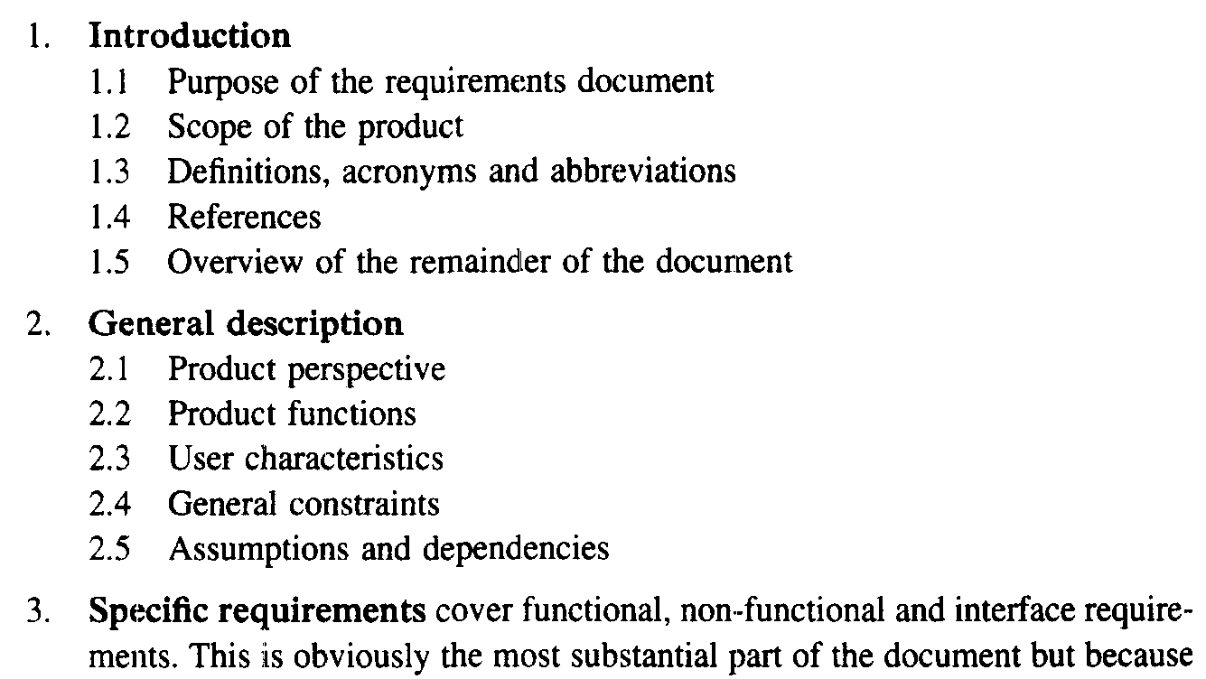
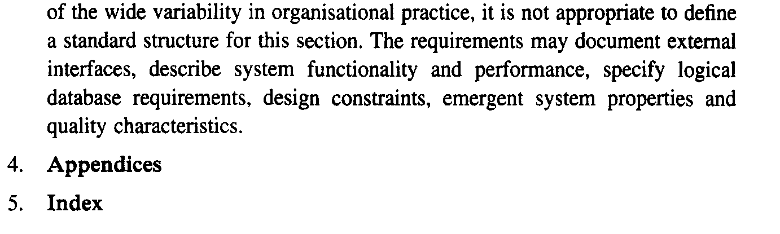
SRS IEEE structure

Slide 116
Requirements Engineering: Requirements Validation
Checking that the requirements specified in the SRS actually define the system that the customer wants and that all requirements are specified
Usually done through group reviews, prototypes.

Slide 117
Requirements Validation Criteria
Correctness: Does the system provide the functions which best support the customer’s needs?
Completeness: Are all functions required by the customer included?
Consistency: Are there any requirements conflicts?
Realism: Can the requirements be implemented given available budget and technology?
Traceability: Each system function should be traced to a corresponding set of functional requirements.
Modular: Can the requirements accommodate change?

